Slide 1

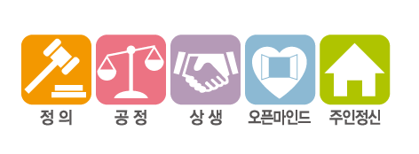
CGBIO Medical Trend Analysis for technical trend and search articles related to the research
시지바이오팀 / 박준규
시지바이오팀 / 조승기
시지바이오팀 / 김필윤
시지바이오팀 / 윤희재

Slide 2

Project Introduction

Slide 3
Index
Project explanation
Data
Sample Data
How to make?
Expectation and Evaluation
3/7

Slide 4
1. Project explanation (guide)
Goal | Provide the information about main article related to the research and development and analysis the trend of medical technique or product
Target | Researcher
Apply to | Research Center
Expectation | It is possible to understand the development trends of products being developed by CGBIO and to collaborate openly by telling them who the experts are. 1) Relevant information can be received daily. 2) Identified by the relevant experts and doubled the amount of meeting with the experts 3) Reduction of work man-hours (8 hours per month)
Details | Summarize the keywords Check the number of data to extract information related to the keywords Provide the trend with visualization about research
4/7

Slide 5
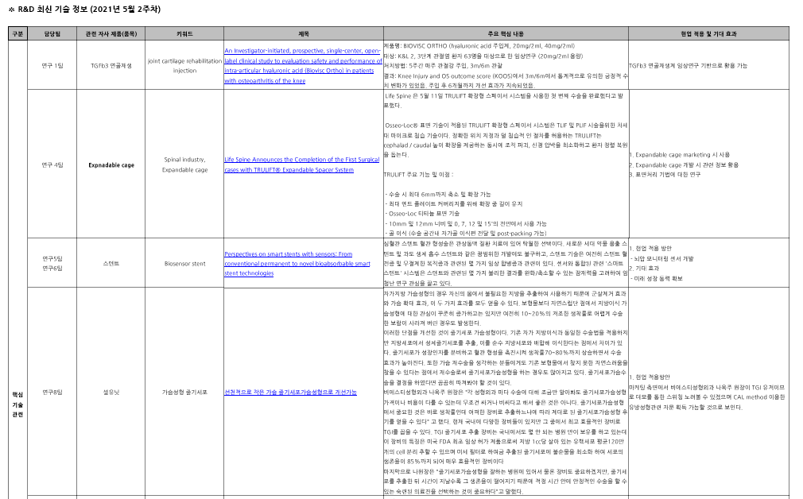
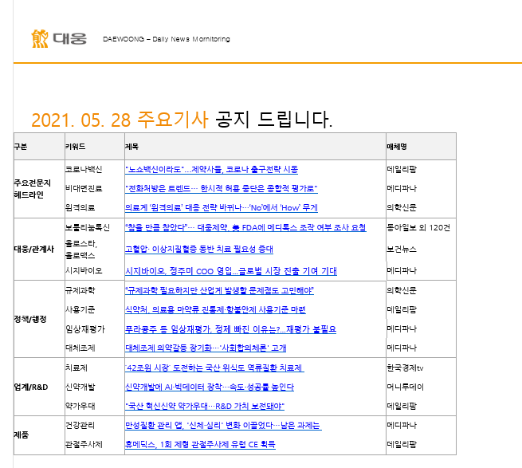
2. Explanation of data (★)
Announcement of 2021.05.28 main article
Part
Keywords
Title of Article
Media name
5/7
5/7

Slide 6
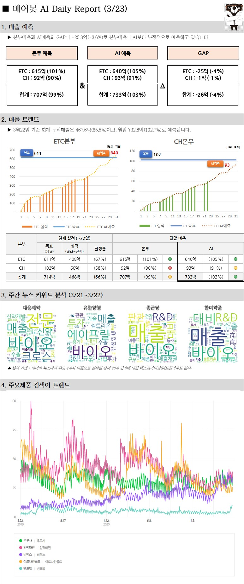
2. Explanation of data (★)
6/7
6/7

Slide 7
2. Explanation of data (★)
“Name of team” AI Daily Article Report
Keywords:
Main article
Technical keyword trend
Analysis of keyword
Product keyword trend
NLP
The number of word
7/7
7/7

Slide 8
3. Sample Data
 | Technical Keywords | Product Keywords | ETC
Research Team 1 | 연골재생, TGF beta-3, BMP-2, 생체재료 의료기기, 골재생 | 골이식재, 연골대체재, 연골활액, 치과용 이식재
Research Team 2 | 유착방지제, 지혈제, 드레싱제, 점착성투명창상피복재, 콜라겐 | 온도감응, 혈액응고, 가피, 흉터, 주름 개선, 세포, 진피, (연)조직 재생 | 차세대, 신규, 혁신, 차별, 경쟁력, 가성비, 재생, 의료기기
Research Team 3 | 광 조사 , 맞춤형 피부 케어, EGF , NPWT(음압상처치료), 혈액 튜브, 박동형 펌프, 항응고 코팅, 욕창 예방 시스템, 원심분리, 음압 마사지 | 의료용흡인기, 광선조사기, 조합자극기, 가슴체적측정기, 체외막심폐순환보조장치, 골수처리기구, 창상피복재
Research Team 4 | spine, spinal implant, spinal fusion device) : surface treatment, hydrophilic, spinal technology, technologies, 3D printing, navigation, innovative, innovation, platform, development, digital surgery, guide, image guided, robotic guided | Expandable cage, 3D printing cage, VBR, vertebral body replacement, ADR, artificial disc replacement, TDR, total disc replacement, joint replacement, MIS, minimal invasive surgery, percutaneous, pedicle screw, pediatric screw, deformity surgery, cervical screw, occipital plate, ACP, anterior cervical plate, translation plate
Research Team 5 | 형상기억합금, 레이저 가공, 전해연마, 화학연마, 혈관 재생, 기계적 혈전 제거술, 코일 색전술, 전기 절제 도자술 | 뇌혈관용 스텐트, 전극카테터, 색전 제거 스텐트, 마이크로카테터, 풍선카테터, 소화기 스텐트 | 뇌혈관 중재시술 의료기기, 소화기 질환 치료 의료기기, 혈관 재생 의료기기
Research Team 6 | hemocompatible coating, Very late thrombosis, thin strut, Scaffold coverage, PCI, Compliance, Scaffold | Bioresorbable Vascular Stent, Poly L-lacticacid, OTW Balloon, suction catheter, delivery system, Balloon catheterDES, DEB | AI medical device
Research Team 7 | 필러, 히알루론산 가교 | 다나에, 페이스템
Research Team 8 | 진피(Dermis), 줄기세포(stem cells), 기질혈관분획(stromal vascular fraction, SVF)" | 셀루닛
Research Team 9 | 맞춤형 임플란트, 3d프린팅/다공체, 3d프린팅 임플란트, 3d프린팅 의료기기 | 3d프린팅 임플란트, 3d프린팅 생체재료, 설계 클라우드 시스템
Research Team 10 | bio 3d print, bio 3d fabrication, ceramic print, ai 3d print, 3d print qc
8/7
8/7

Slide 9
4. Data analysis
1. Data usage
Check the data in the research engine like Google or Naver and architect the algorithm
2. Summarize the data and Setting the frame
2.1 Remove outlier and make a setting for the number of data that we’re going to show
2.2 Merge data: Construct the DB and integrate into a structured framework
3. How to analyze
3.1. Check the accuracy about the article that the engine recommend to us
3.2. Survey the satisfaction and utilization in the Center
3.3. Identification of operational man-hours before and after application
4. Business application

Slide 10
4. Expectation and Evaluation
Expectation | Daily update about the interested keywords. Increase open collaboration by identifying trends and experts in technologies and products of interest Reduced work hours (8 hours a month > 10 minutes a month) Quick overview when researching new products and technologies
Proof of the expectation | It is investigated and organized by research center officials every two weeks to investigate existing research and development trends and investigate articles. It takes 4 hours per month). It takes a long time to search because it is difficult for experts to understand related technologies and products..
Evaluation | Satisfaction survey in the research center Survey how much they did the open collaboration before and after implementation
10/7

Slide 11
Current Progress

Slide 12
Index
Overview
Problem: the Google Block
Solutions:
Request Randomization
Realistic Headers
CAPTCHA detector
Rotating Proxies
Author and Journal parsing
SQL Database Upload
Natural Language Processing
12/7

Slide 13
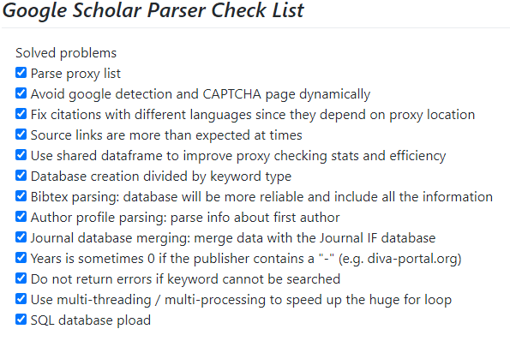
1. Overview

Slide 14
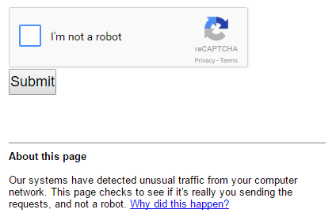
2. Problem: the Google Block
Google blocks parsers and bots with CAPTCHA after too many requests.
CAPTCHA stands for the Completely Automated Public Turing test to tell Computers and Humans Apart.

Slide 15
3. Solutions
2. Use realistic headers
1. Randomize request time
3. CAPTCHA detector
4. Use rotating proxies

Slide 16



3.1. Time randomization
We can bypass some detections by:
Waiting more than ~0.6 seconds between requests
Randomizing the time between requests

Slide 17
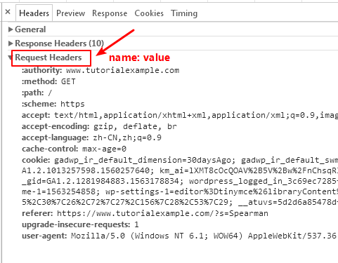
3.2. Realistic headers
Headers contain information about the browser and OS, by using them we can “fake” the browser we are using
Also, we can add some other information, such as the referer
Tip: rotating the headers too may also avoid some detection

Slide 18
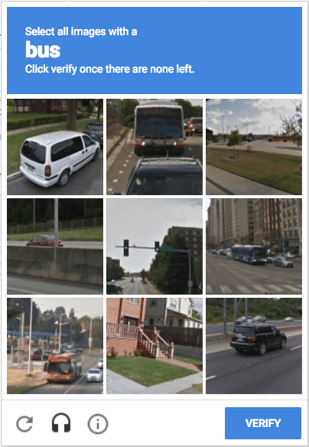
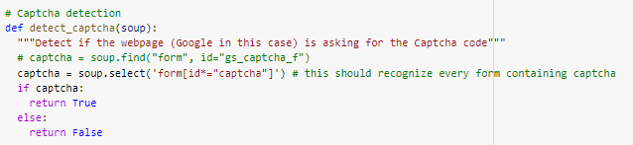
3.3. CAPTCHA detector
Even with randomized times and headers, Google will know if there is a bot after some time
We need to detect those pesky CAPTCHAs!
It turns out, most of the time it is pretty easy by searching for any captcha instance in the webpage

Slide 19
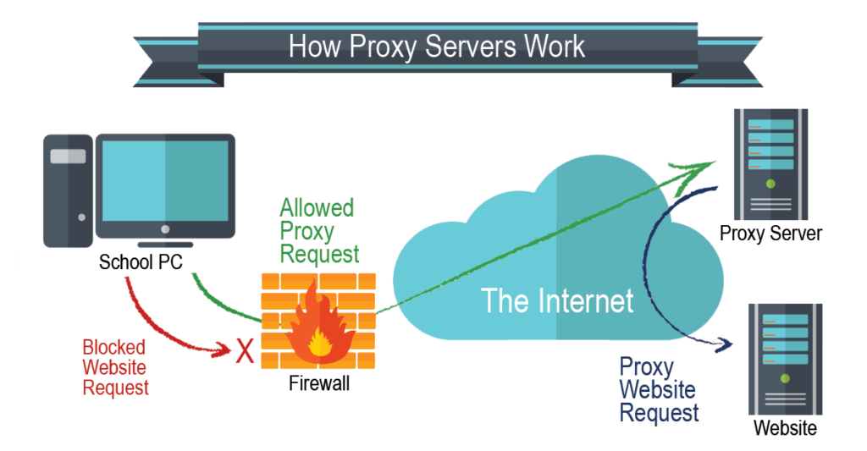
3.4. Rotating proxies
Even so, when detecting a CAPTCHA the parsing has to stop. We want a way to continue scraping after detection
🡪 Use proxy servers!

Slide 20

3.4. Rotating proxies (continued)
There are mainly two ways of obtaining proxy access:
Paid: most obvious solutions, some services even provide APIs for rotating their proxies and are very reliable. Con: may cost several thousands of dollars!
Free: we need to obtain a reliable proxy list which is update over time
Solution: https://github.com/monosans/proxy-list
This repository is constantly updated by Linus Torvalds!
Linus is the creator of Linux (probably running on your smartphone right now), so I’d say he is trustworthy ☺

Slide 21

3.4. Rotating proxies (continued)
Now we just need to connect to the proxies!
We create a dynamic list in which:
1. Timeouts: If a proxy does not respond, we move its position to the last row and try another one, increasing its timeout counter
1. Blocks: If a proxy is detected and blocked by Google, we move its position to the last row and try another one, increasing its blocked counter
We can see that this method makes it possible to reuse good servers: sometimes, they may handle hundreds of requests before being blocked!

Slide 22
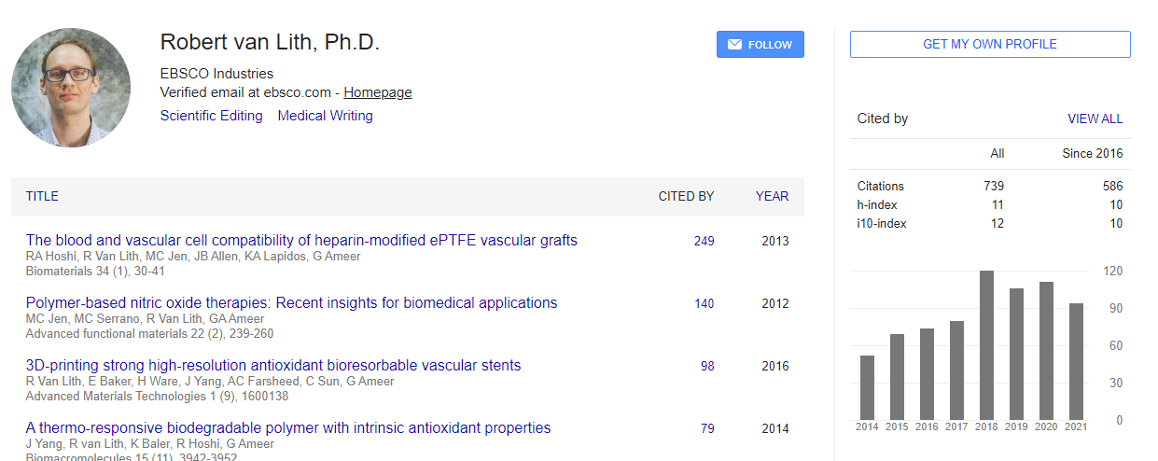

4a. Author parsing
We can obtain author information by collecting links leading to their profiles:
To parse the full author list, which is not available in the Scholar main page, we also parse the BibTeX link directly

Slide 23
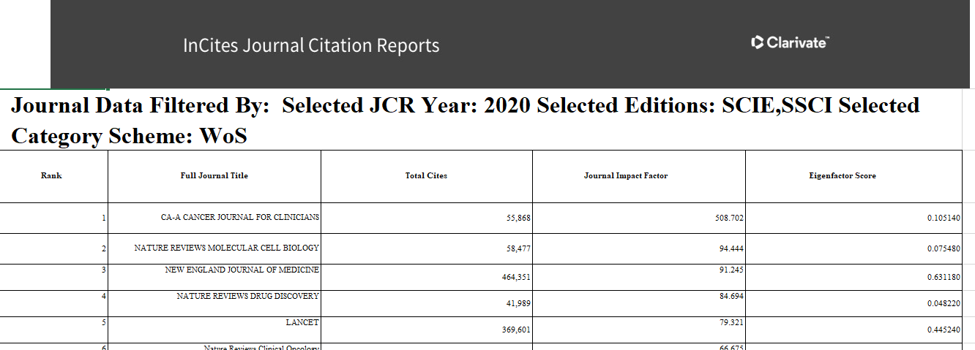
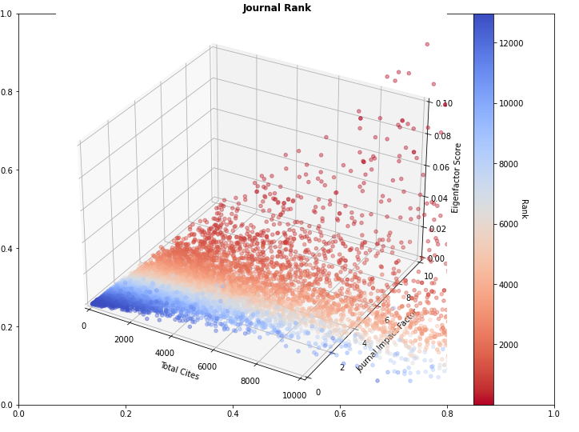
4b. Journal parsing
We collect data of the journals statistics with impact factors:

Slide 24
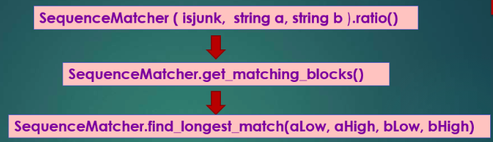
4b. Journal parsing (continued)
We want to create a database with articles and their journal impact factor. But some names are a bit different in Google and not many results are returned
Solution: we use a vectorized version of Sequence Matcher (quadratic complexity in worst case scenario), and improved solution over the Ratcliff-Obershelp algorithm (worst-case: cubic in time)

Slide 25
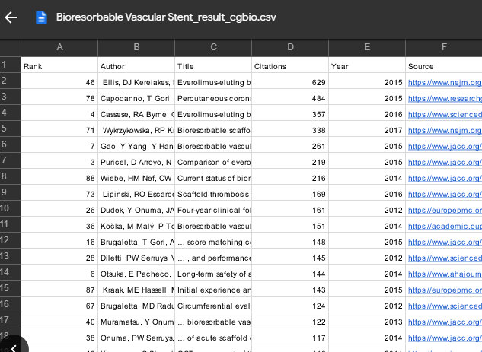



5. Uploading results to SQL database
We upload to Amazon WebServices RDS databases to make data easily accessible:

Slide 26
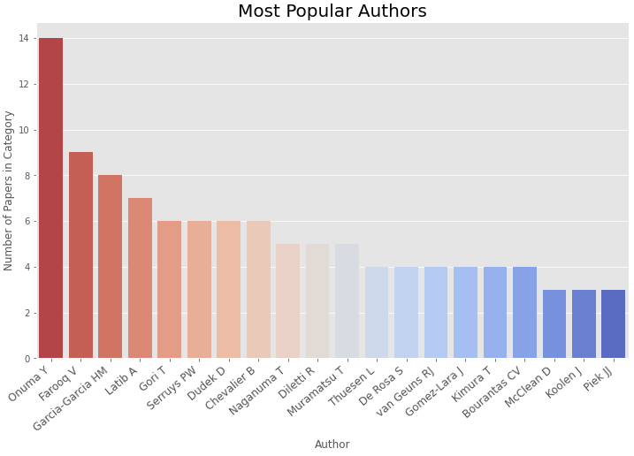
6. Natural Language Processing (NLP)
We can collect the data by keyword and run approximate string matching to identify top researchers in the area:
Author ordering by number of papers in each category

Slide 27
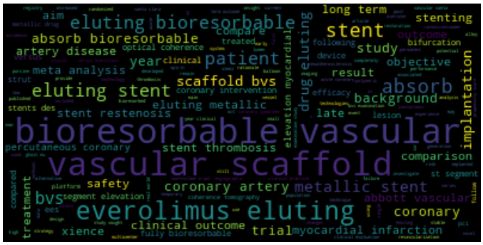
6. Natural Language Processing (NLP)
We can also run NLP to identify the most important words in titles and article summaries and organize them in easily accessible word clouds:
Words ordered by number of appearances. We could also give more importance to papers with more citations, higher IF, etc

Slide 28
Future Development and Conclusions

Slide 29


Future development - Scraper
Extension to other websites: Naver and other Korean websites could be useful for Daewoong to obtain information
(Hardcore) we could even extend by collecting the entire articles!
Webpage articles → web parsing
PDF articles → more advanced techniques, still feasible (pdf2text, etc)

Slide 30
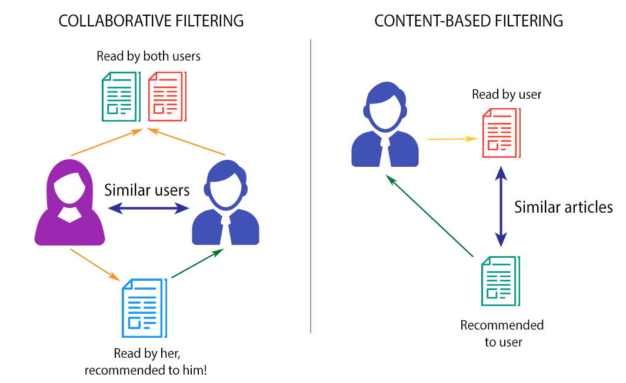
Future development - AI Recommendation System
Based on big data, we can do tailored recommendations based on colleagues’ interest (daily, weekly… etc)
Use visualization tools (e.g., trend graphs, Word Clouds)

Slide 31

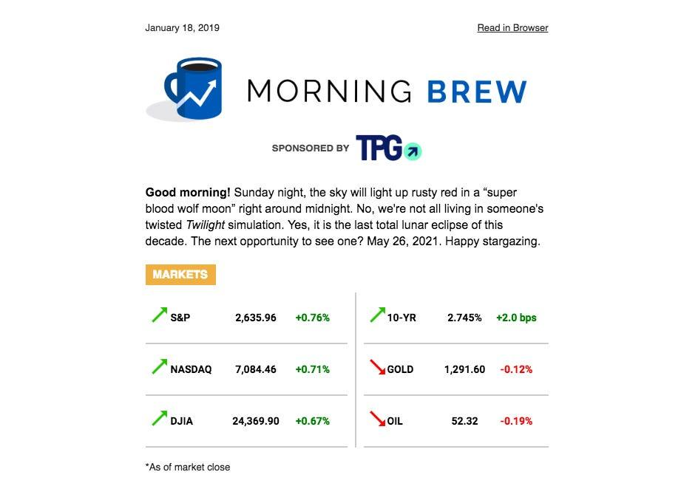
Future development - GUI
Build user interface for easy accessibility
A format I personally like is the one from Morning Brew summarizing daily news via email (html)

Slide 32
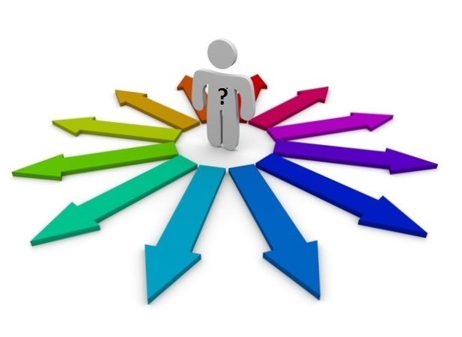
Conclusions
There are many possible future directions, and it will be interesting to see how obtaining more and more data (maybe also integrating user satisfaction) can generate a good recommendation system.
In my opinion, the project can make a difference in identifying new trends and help people discover new ways to solve problems. It will be interesting to see how the project develops and how future directions can branch and give meaningful results!

Slide 33
Thank you!

